Slide 1
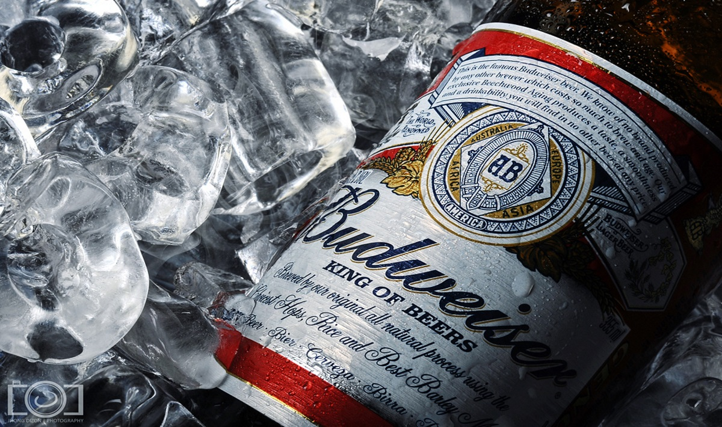
Beer and brewery Analysis
Adam Ercanbrack
Emmanuel Opoku

Slide 2
Agenda
A review of the data provided – To perform exploratory data analysis on international beer bitterness(IBU) and Alcohol Volume (ABV) by State and brewery
Data Acquisition – Beer data and Brewery data were obtained in CSV format
Data Preparation –Steps taken to fill the gaps for missing values.
Data Visualization – Graphs were created using ggplot in R studio
A Discussion on Ales vs. Indian Pale Ales – A deeper analysis using knn to determine differences between Ales and IPAs.
Discussion of Recommendations – An introduction to research possibilities and market exploitables.

Slide 3
Data Preparation
Total number of records
Beer Dataset: 2410 records
Brewery Dataset: 558 records
Following missing values were found:
Beer Dataset: IBU (1005 records), ABV (62 records), Style (4 records)
Missing values treatment:
We do not know why there are gaps in the data for the IBU and ABV.
We will replace those values, first by seeking open-source information on the values and secondly by taking the median of each state and replacing the remaining NA values with those median values.

Slide 4
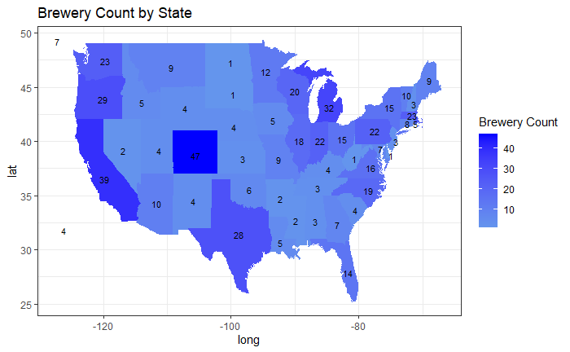
Number of breweries per State
Colorado has the highest number of breweries with 47
DC, Delaware, ND, SD, and WV all have the least with 1 brewery each
NB: Please see the next slide for full list of breweries by state

Slide 5
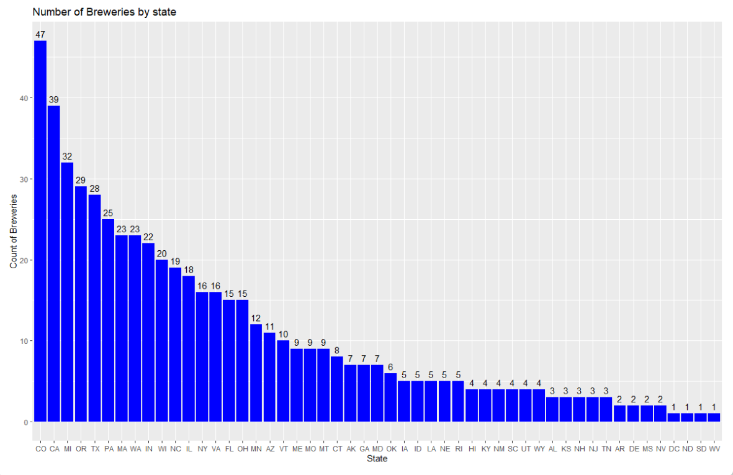
Number of breweries per State
Distribution of Breweries by State

Slide 6
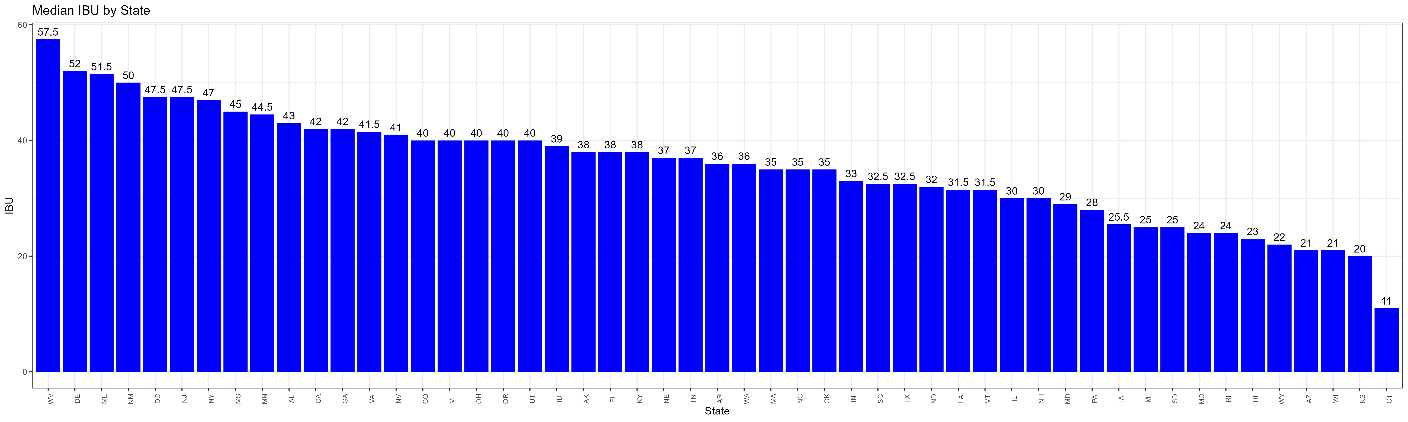
Median IBU (Bitterness) by State
Key Highlights
WV leads the pack in Median IBU with a level of 57.5 and followed closely by DE with a level 0f 52.

Slide 7
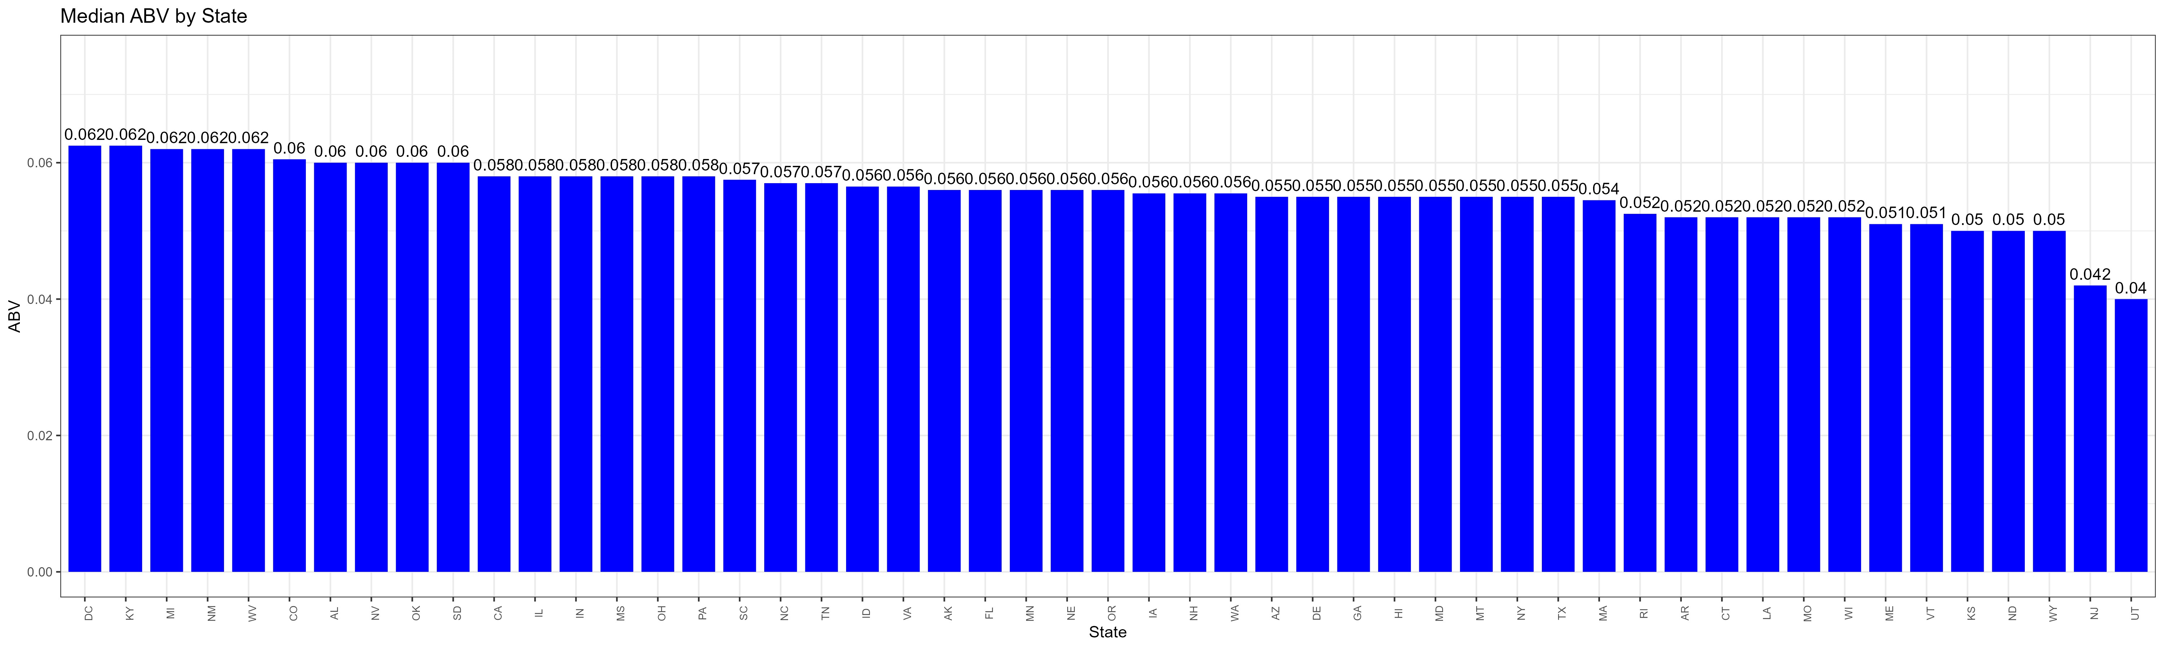
Median Alcohol Content (ABV)
Key Highlights
The median alcohol content looks to be fairly distributed across states for the most part of the data
No significant ABV outliers were detected

Slide 8
Other Interesting Findings
Lee Hill Series Vol. 5 - Belgian Style Quadrupel Ale from CO with an ABV of 0.128
State with the highest average alcohol level in ( ABV) beer.
District of Columbia (DC) and Kentucky (KY) tied with for the top spot with an ABV level of 0.0625 each
The most alcoholic beer was Lee Hill Series Vol. 5 – Belgian Style Quadruple Ale from Colorado with an ABV rating of 0.128.
State with the most bitter beer on Average. (IBU)
West Virginia has the most bitter beer on average with a median IBU level of 57.5
The most bitter beer was the Quaff India Style Session Ale from Oregon with an IBU rating of 138.

Slide 9
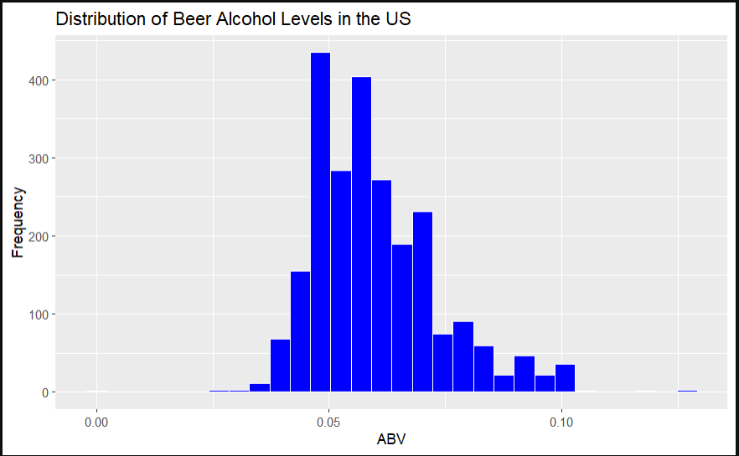
Summary Statistic and Distribution for ABV
Min. 1st Qu. Medan Mean 3rd Qu. Max.
0.001 0.050 0.057 0.060 0.067 0.128
Key Highlights
The distribution for ABV across the data appears to be left skewed due to some extreme outliers with most observations between 0.05 and 0.06

Slide 10
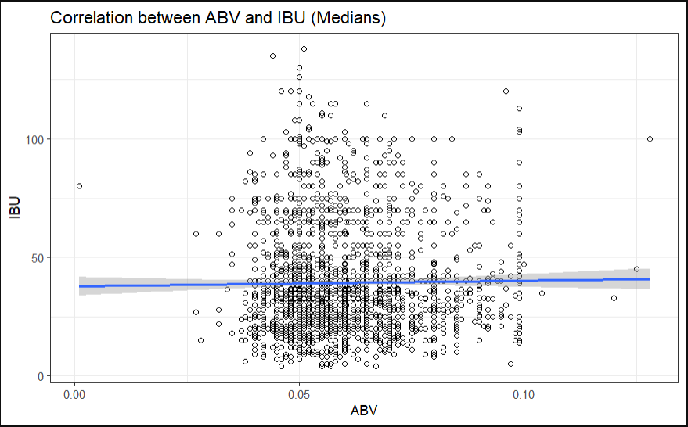
Relationship between IBU and ABV of Beers
Key Highlights
From the plot above, there does not appear to be a correlation between ABV and IBU. As most observations appear to be evenly distributed.
This point of view is confirmed further with the regression line included in the plot.

Slide 11
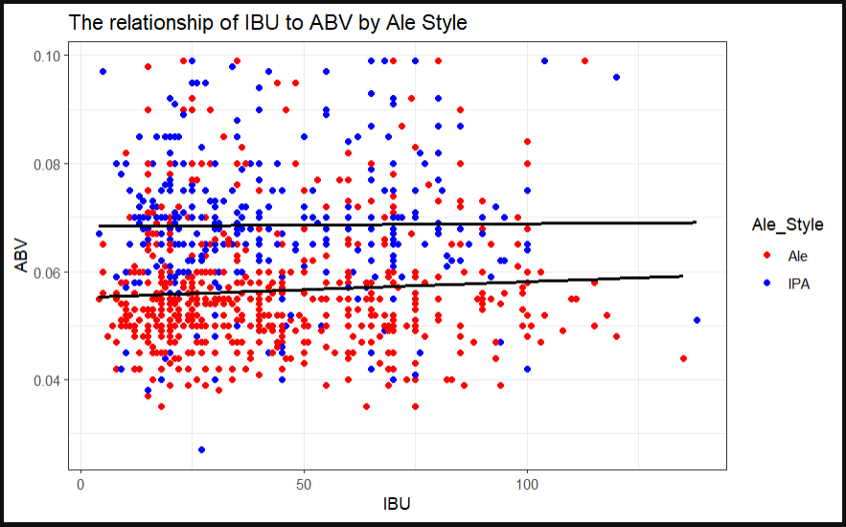
Comparison of Ale and Indian Pale Ale
Key Highlights
From the plot above, we can see that Indian Pale Ale has a higher alcohol level than most regular Ales.
The regression line shows approximately a 1.2 percent difference in the alcohol levels.

Slide 12
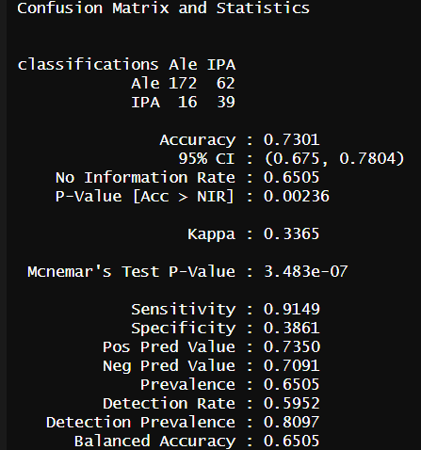
Comparison of Ale and Indian Pale Ale
Key Highlights
A review of this difference using K-Nearest Neighbor (KNN) analysis shows that the sensitivity for correctly identifying ale was approximately 91 percent
This suggests that there is a clear difference between Ale and Indian Pale Ale in alcohol levels with an overall accuracy of 73 percent.
We conducted 500 iterations of this test to determine the best k fit of 13 for accuracy. We are 95 percent confident that the correct accuracy falls between 68 and 78 percent.

Slide 13
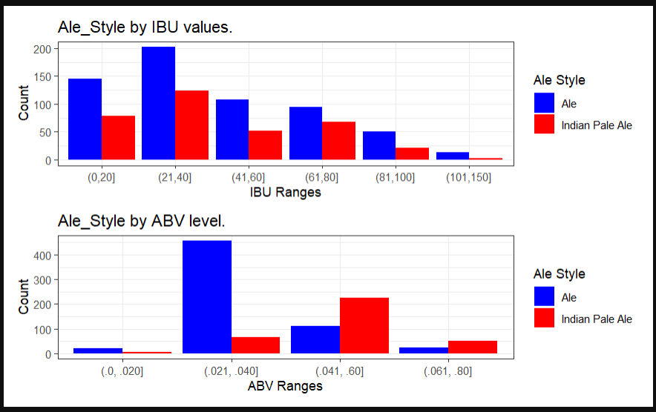
Comparison of Ale and Indian Pale Ale
Key Highlights
A further review of this difference is confirmed with a binned comparison of Ale and Indian Pale Ale, showing that Ale has a greater number of products across all bitterness levels.
Ale tends to have more products with lower alcohol levels than with higher alcohol levels where Indian Pale Ale tends to dominate.

Slide 14
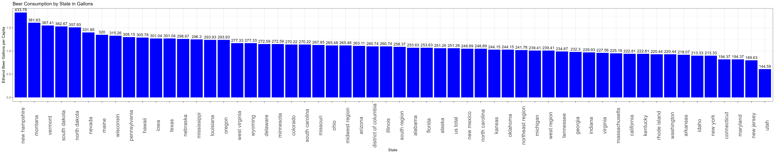
Beer Consumption by State
Key Highlights
The highest per capita consumption rate falls to New Hampshire.

Slide 15
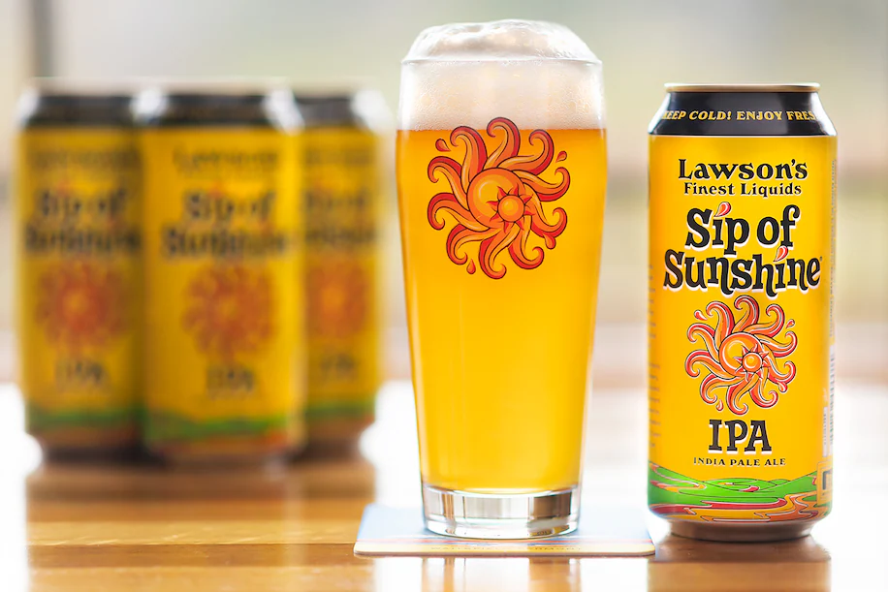
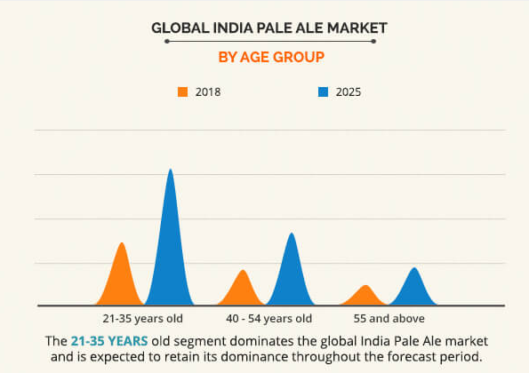
Beer Recommendations
Key Highlights
Craft Beers with higher alcohol content seem to be on the rise in popularity. (High ABV and nonalcoholic beers are dominating the craft beer industry - The Washington Post)
However, IPA are the best selling craft-beers and much more popular in certain regions than others. India Pale Ale Market Size, Share, Growth | Analysis Report 2025 (alliedmarketresearch.com)

Slide 16
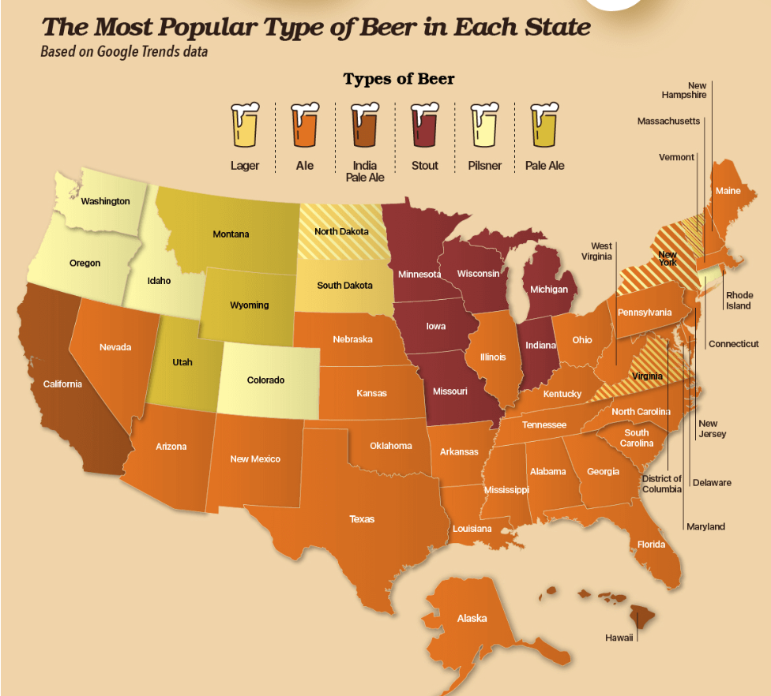
Beer Recommendations
Key Highlights
Indian Pale Ale is most popular in California, the most populated state.
American Ales are more broadly consumed in the south. The Most Popular Beer in Every State - Grillio

Slide 17
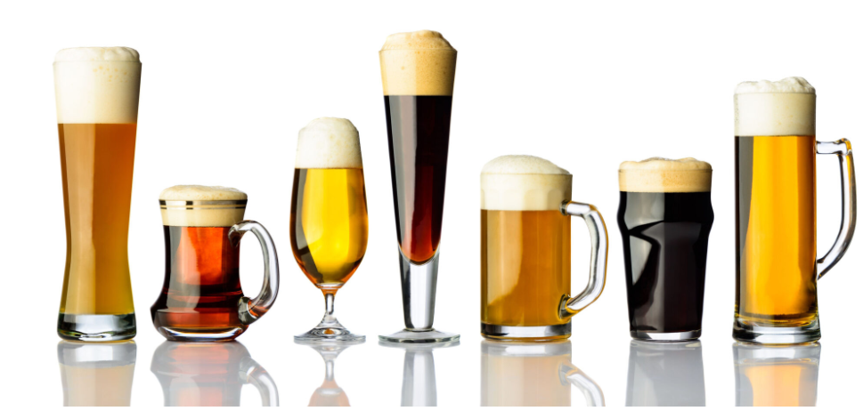
Beer Recommendations
Key Highlights
Our recommendations are to gather more information to precisely target specific regions where certain styles are popular.
There is clearly a market for Indian Pale ales on the west coast.
However, a broader number of consumers favor a more alcoholic ales, which could be a break-in market.
We can provide you with the analysis you need to make the smartest decisions for pursuing new markets.

Slide 18
Conclusions
The data provided is dirty but could be cleaned and augmented to provide greater insights.
American ales have greater alcohol content than IPAs.
There is a growing demand for alcohol level increases.
IPAs dominate in the west coast markets.
IPAs are increasingly competing against lagers as a beverage of choice.
We can provide the research and data to focus future development and production.

Slide 19
Questions?

